Slide 1

Dr. YSR ANU College of Engineering & Technology Acharya Nagarjuna University, Guntur-522510
SIMULATION AND STUDY OF MULTILEVEL INVERTER
Project Review : (Batch-11)
Submitted by :
1)Vaddi .Susi (Y20EE3259)
2)D . Renuka (Y20EE3210)
3)Usurumati . Karthik (Y20EE3258)
4)K.Naveen Reddy(Y20EE3225)
Project Guide :
Dr. CH. RAVI KUMAR
Assistant professor
DEPARTMENT OF ELECTRICAL ENGINEERING

Slide 2
CONTENTS:
Abstract
Objectives
Introduction
Multilevel inverter
Cascaded H-Bridge Multilevel Inverter
PWM
Simulation of Three-level inverter
Simulation of Five level inverter
Comparison
Conclusion

Slide 3
Abstract
Nowadays multilevel inverters are a very attractive solution for medium–voltage high-power conversion applications; they convert DC power to AC power at the required output voltage and frequency level. Pulse Modulated Switching Cascaded H-bridge Multilevel Inverter can be utilized for the reduction of Total Harmonic Distortion (THD). In high and medium-power applications, multilevel inverters are commonly used. Because of the presence of harmonics in this scenario, THD has an impact on the overall efficiency of power electronics devices. To obtain optimal switching angles for harmonic reduction and to compare the THD content of the output waveform.

Slide 4
Objectives
In order to overcome the problem of distortion in the output voltage waveform caused due to the presence of harmonics, this project proposes the modelling of Multi-level Inverters using MATLAB/SIMULINK. The objectives of the work are:
To Study and simulate Multi-level Voltage Source Inverters.
Comparison in performance of multi-level inverters.
To perform %THD analysis for multilevel inverters and compare its values.

Slide 5
INTRODUCTION
Demand for energy is increasing day by day. The key source of energy available now is from non-renewable sources like fossil fuels. The overutilization of these sources to meet our daily requirements has put it in a degradation state. Hence, there is a rapid development in the research to produce energy from alternate sources, such as wind, solar, tidal, etc. Among them, energy taken from photovoltaic systems plays an important role. The energy which is taken from a photovoltaic system (PV system) is DC in nature. Most of the equipment is used for domestic and industrial purposes which work on an AC source, the DC output from a PV system is converted into an AC and for this purpose, power inverters play a major role.

Slide 6
Multilevel Inverter
They combine switched waveforms with lower levels of harmonic distortion than an equivalently rated two-level converter.
It found that with the increase in level, the steps increase and the output waveform approaches to a near sinusoidal waveform.
Thus, it reduces the THD with the disadvantage of complex control and voltage imbalance problems These smaller voltage steps help in creating high-quality waveforms, lower dv/dt, and reduced electromagnetic compatibility.
.The high switching frequency employed in multilevel inverters helps minimize the output harmonics and reduces the passive component size in the power circuit.

Slide 7
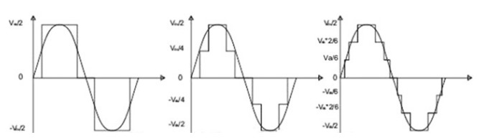
Cascaded H-Bridge Multilevel Inverter
The concept of a multilevel inverter is based on connecting H-bridge inverters in series to get a sinusoidal voltage output.
One full-bridge is itself a three-level cascaded H-bridge multilevel inverter and every module added in the cascade which extends the inverter with two voltage levels.
Each full-bridge inverter can create three voltages VDC, 0, and −VDC.

Slide 8
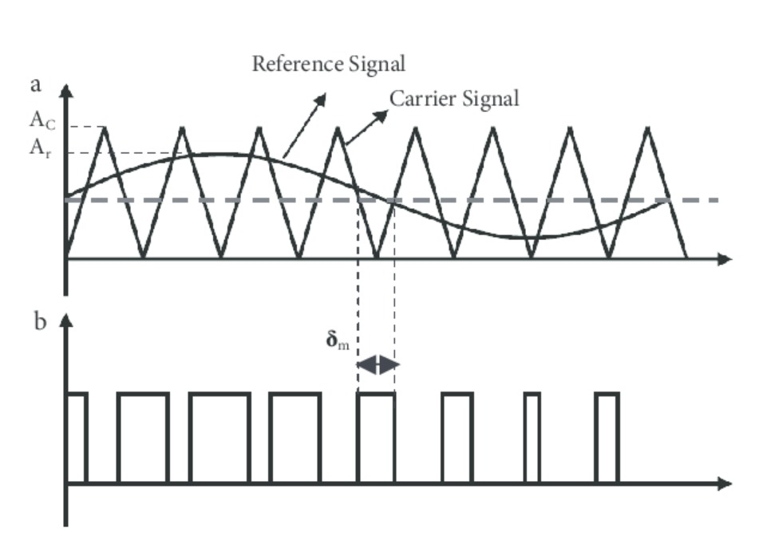
PWM:

Slide 9
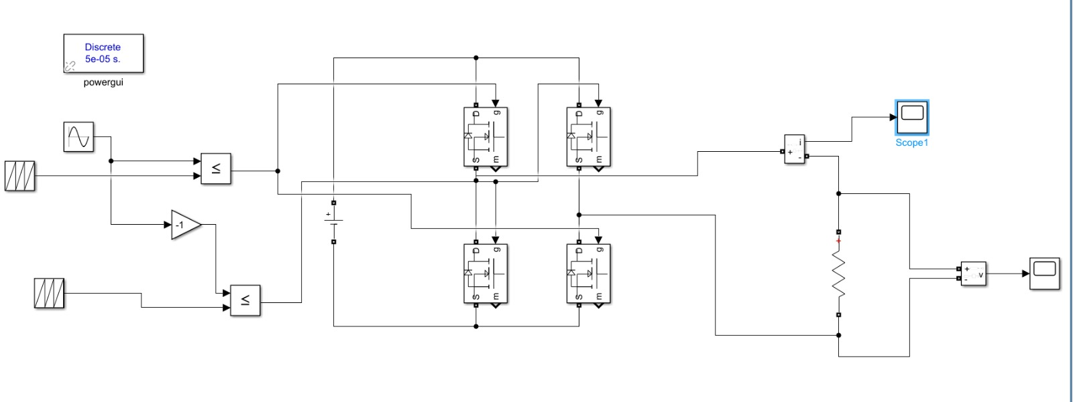
SIMULATION OF THREE-LEVEL INVERTER

Slide 10
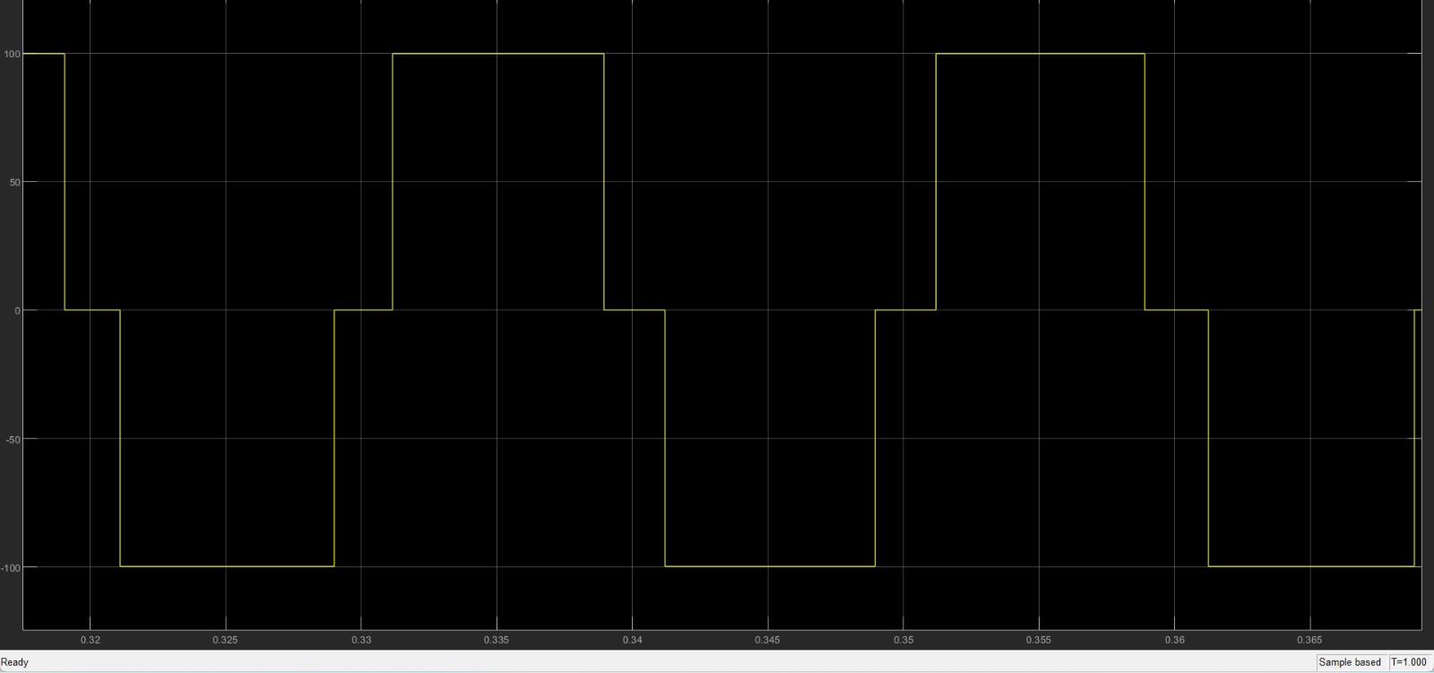
WAVEFORM FOR THREE-LEVEL INVERTER

Slide 11
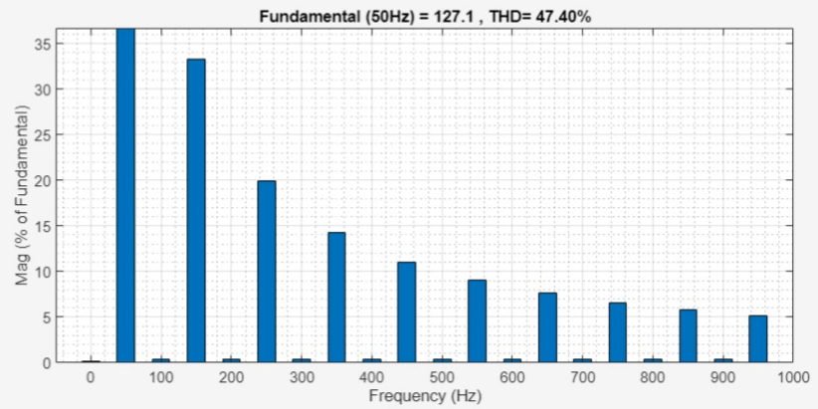
THD FOR THREE-LEVEL INVERTER

Slide 12
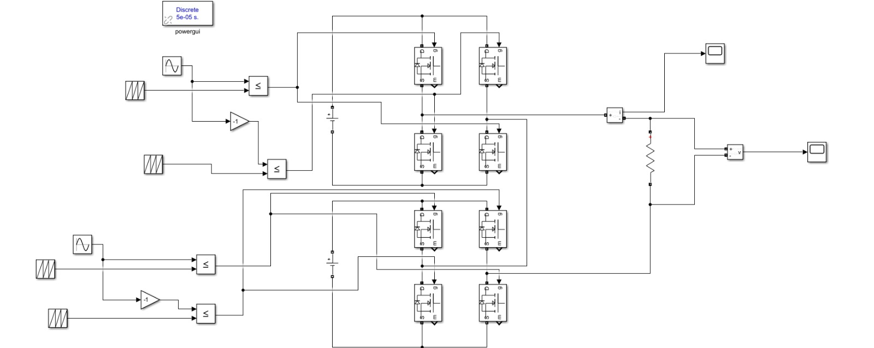
SIMULATION OF FIVE-LEVEL INVERTER

Slide 13
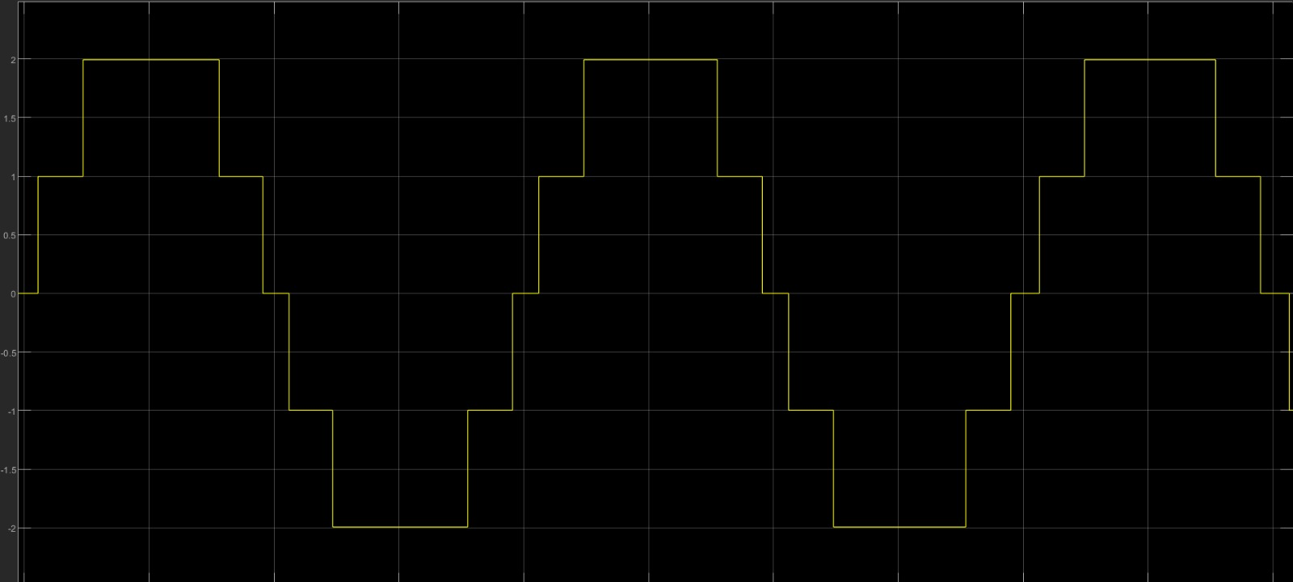
WAVEFORM FOR FIVE-LEVEL INVERTER

Slide 14
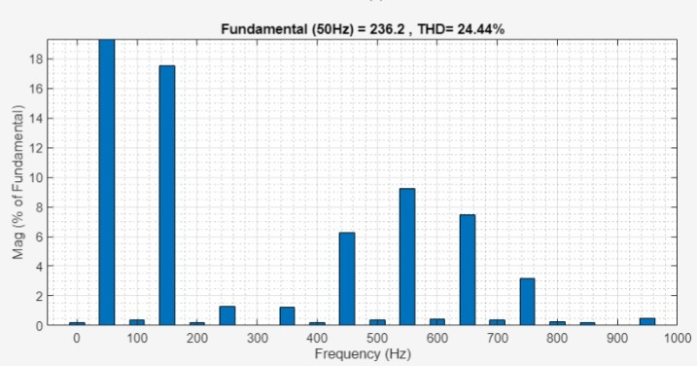
THD FOR FIVE-LEVEL INVERTER

Slide 15
Comparison
properties | Three level Inverter | Five level Inverter
THD | THD is around 54% | THD is around 24.4%
Power Rating | Applicable for high power ratings | Application in high power ratings
Switches required | Compare to five level it required less no of switches | Required more no of switches as the level increases
Efficiency | Efficiency is around 93% | Efficiency is around 96%

Slide 16
Advantages
Better waveform quality of output voltage.
Reduced dv/dt , leading to reduction in EMI.
Multilevel Converters produced smaller CM voltage , therefore, the stress in the bearings of a motor connected to a multilevel inverter motor drives can be reduced .
Lower voltage rating devices can be used .

Slide 17
Conclusion

Slide 18


